Slide 1
DESIGN AND OPTIMIZATION PROJECT Optimizing Supply Chain Order Allocation with Mixed Integer Programming [1]
Design and Optimization – VÉL113F
Paul Grassi, Leander Merbecks, Gaëtan Petri, Valentin Schmeller
06th November, 2024

Slide 2



PROBLEM DEFINITION
Plants
Ports
Industrial engineering problem
Double optimization: order production and product delivery
Meet customer demand while minimizing overall operational costs
Customers
Product orders
Product to deliver
Customer satisfaction

Slide 3
DATASET OVERVIEW
Data from a large Excel file based on a real case study
7 tables described below :
Order List: Order details like product ID, customer, destination port, quantity, weight.
FreightRates: Shipping rates based on origin, destination, and weight.
WhCosts: Storage costs for each plant.
WhCapacities: Daily capacity limits per plant.
ProductsPerPlant: Product compatibility by plant.
VmiCustomers: Exclusive plant assignments for certain customers.
PlantPorts: Connections between plants and ports.

Slide 4
DATA PROCESSING
Sometimes confusing data. Below are the choices we made in data processing:
OrderList: Key details only—product, destination port, customer, quantity, and weight. Omitted irrelevant fields like order origin, service level, and plant code
FreightRates: Mean averaged fixed and weight dependent costs per each origin port to minimize shipping costs
WhCosts: Per-unit costs for production cost calculations
WhCapacities, ProductsPerPlant, VmiCustomers, PlantPorts: No adjustments needed; directly imposed as constraints for plant capacity, product compatibility, exclusive customer assignments, and plant-port connections

Slide 5
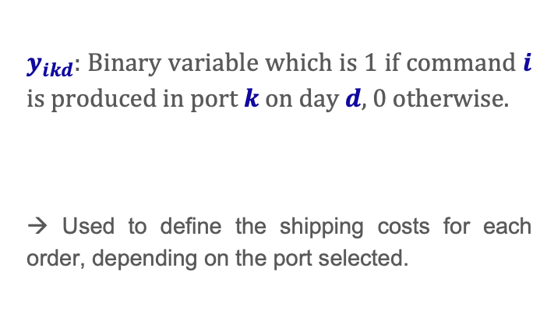

DECISION VARIABLES
Plants
Ports
$x_{ijd}$ : Binary variable which is equal to 1 if order $i$ is produced in plant $j$ on day $d$, 0 otherwise.
→ Used for defining production costs for each order, based on the plant assignment.
$y_{ikd}$: Binary variable which is 1 if command $i$ is produced in port $k$ on day$d$, 0 otherwise.
→ Used to define the shipping costs for each order, depending on the port selected.
Notes:
If we are asked why we add the days:
Just multiplying the capacities omits a LOT of information
You are unable to allocate the orders correctly keeping inside the order limits
Hypothetically you assign too many orders to a plant on a day and it becomes overloaded.

Slide 6
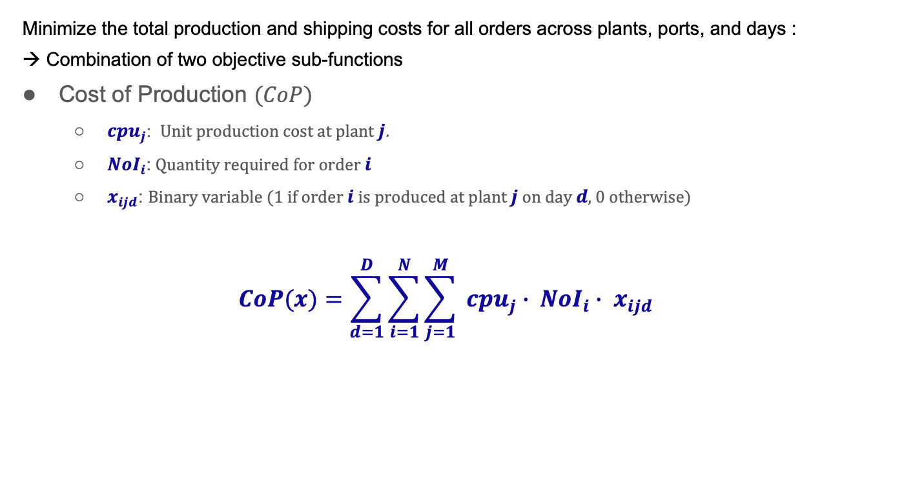
OBJECTIVE FUNCTION (part.1)
Minimize the total production and shipping costs for all orders across plants, ports, and days : → Combination of two objective sub-functions
Cost of Production $(CoP)$
${cpu}_{j}$: Unit production cost at plant $j$.
${NoI}_{i}$: Quantity required for order $i$
$x_{ijd}$: Binary variable (1 if order $i$ is produced at plant $j$ on day $d$, 0 otherwise)
$$CoP(x)=\sum_{d=1}^{D}{\sum_{i=1}^{N}{\sum_{j=1}^{M}{ {cpu}_{j}∙ {NoI}_{i}∙ x_{ijd}}}}$$

Slide 7
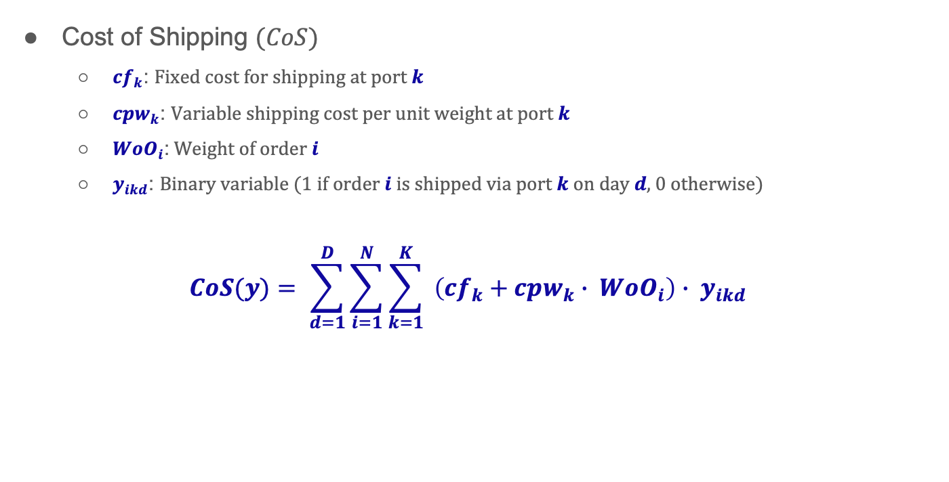
OBJECTIVE FUNCTION (part.2)
Cost of Shipping $(CoS)$
${cf}_{k}$: Fixed cost for shipping at port $k$
${cpw}_{k}$: Variable shipping cost per unit weight at port $k$
${WoO}_{i}$: Weight of order $i$
$y_{ikd}$: Binary variable (1 if order $i$ is shipped via port $k$ on day $d$, 0 otherwise)
$$CoS(y)= \sum_{d=1}^{D}{\sum_{i=1}^{N}{\sum_{k=1}^{K}{ \left(cf_{k}+{cpw}_{k}∙ {WoO}_{i}\right)∙ y_{ikd}}}}$$

Slide 8
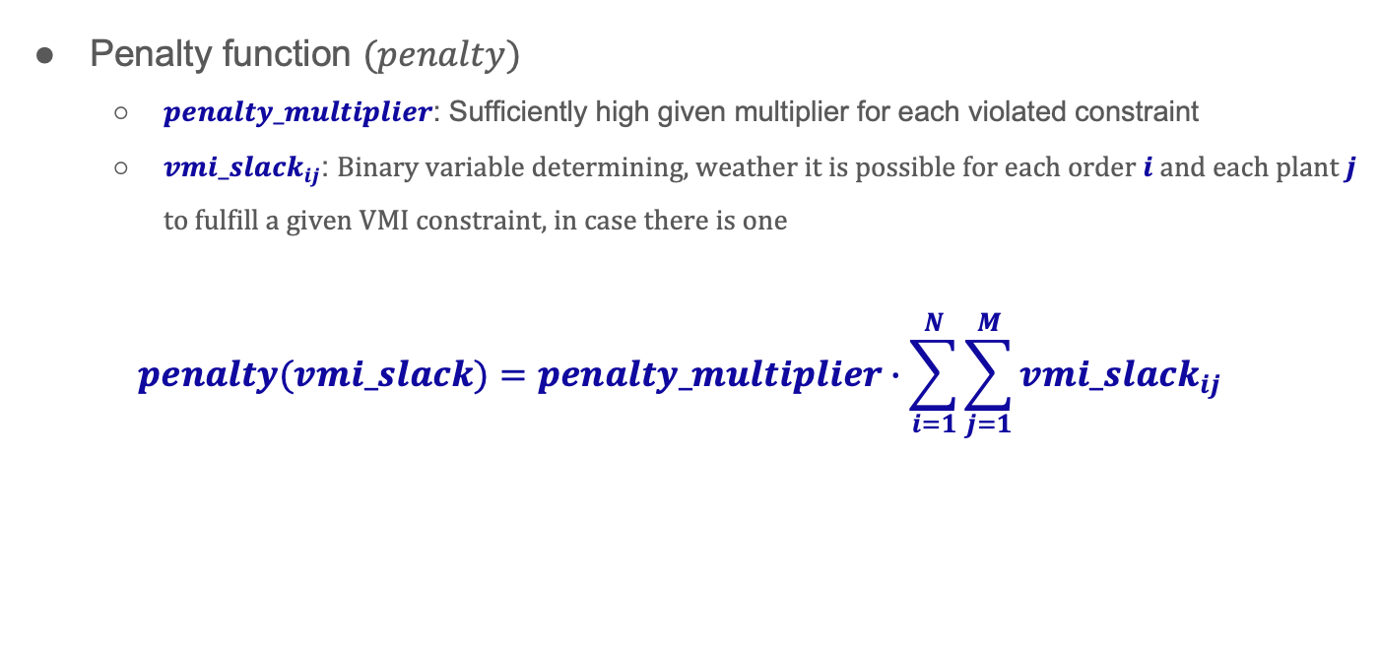
OBJECTIVE FUNCTION (part.3)
Penalty function $(penalty)$
$penalty_multiplier$: Sufficiently high given multiplier for each violated constraint
${vmi_slack}_{ij}$: Binary variable determining, weather it is possible for each order $i$ and each plant $j$ to fulfill a given VMI constraint, in case there is one
$$penalty(vmi_slack)=penalty_multiplier∙\sum_{i=1}^{N}{\sum_{j=1}^{M}{vmi_slack_{ij}}}$$

Slide 9
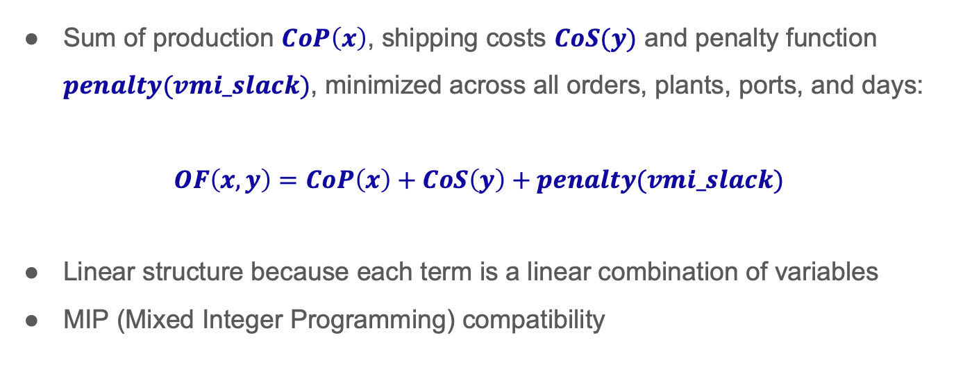
OBJECTIVE FUNCTION (part.4)
Sum of production $CoP\left(x\right)$, shipping costs $CoS(y)$ and penalty function $penalty(vmi_slack)$, minimized across all orders, plants, ports, and days:
$$OF\left(x,y\right)=CoP\left(x\right)+CoS\left(y\right)+penalty(vmi_slack)$$
Linear structure because each term is a linear combination of variables
MIP (Mixed Integer Programming) compatibility

Slide 10
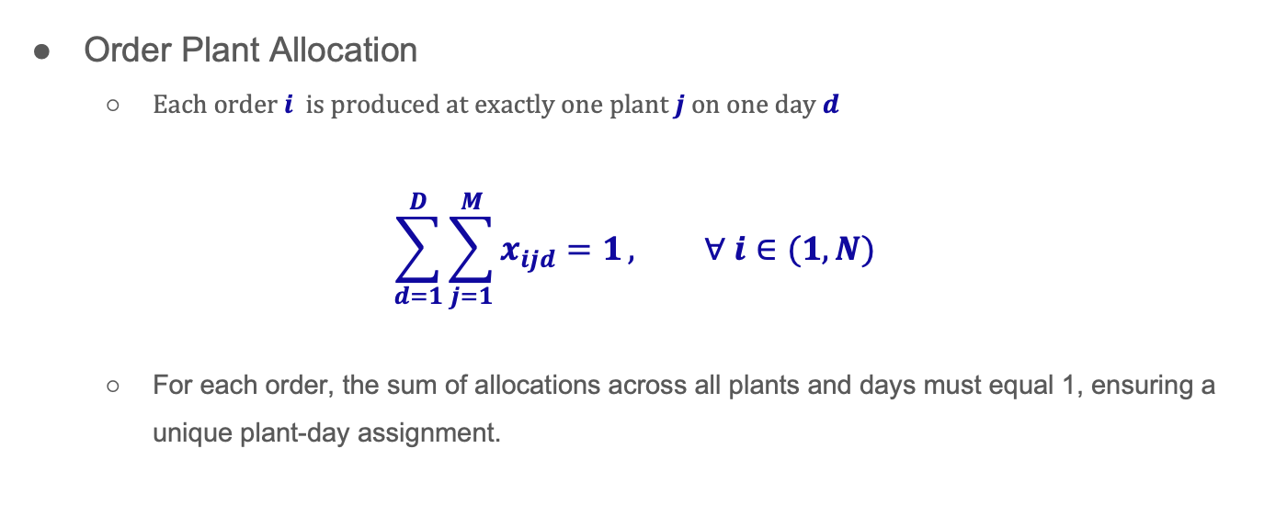
EQUALITY CONSTRAINTS (part.1)
Order Plant Allocation
Each order $i$ is produced at exactly one plant $j$ on one day $d$
$$\sum_{d=1}^{D}{\sum_{j=1}^{M}{x_{ijd}=1}}, ∀ i∈(1, N)$$
For each order, the sum of allocations across all plants and days must equal 1, ensuring a unique plant-day assignment.

Slide 11
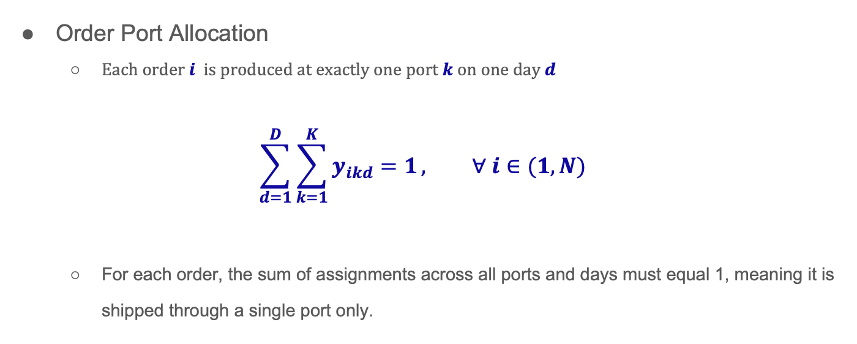
EQUALITY CONSTRAINTS (part.2)
Order Port Allocation
Each order $i$ is produced at exactly one port $k$ on one day $d$
$$\sum_{d=1}^{D}{\sum_{k=1}^{K}{y_{ikd}=1}}, ∀ i∈(1, N)$$
For each order, the sum of assignments across all ports and days must equal 1, meaning it is shipped through a single port only.

Slide 12
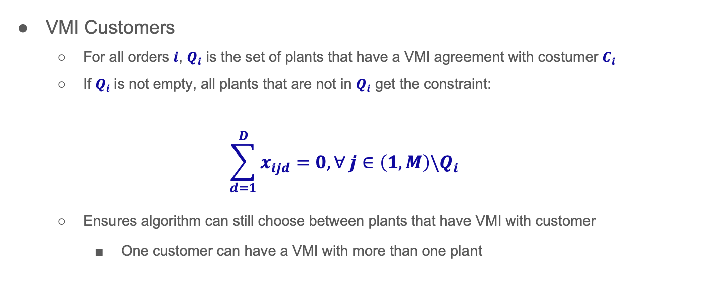
EQUALITY CONSTRAINTS (part.3a)
VMI Customers
For all orders $i$, $Q_{i}$ is the set of plants that have a VMI agreement with costumer $C_{i}$
If $Q_{i}$is not empty, all plants that are not in $Q_{i}$ get the constraint:
$$\sum_{d=1}^{D}{x_{ijd}}=0, ∀ j∈\left(1,M\right)\backslash Q_{i}$$
Ensures algorithm can still choose between plants that have VMI with customer
One customer can have a VMI with more than one plant

Slide 13
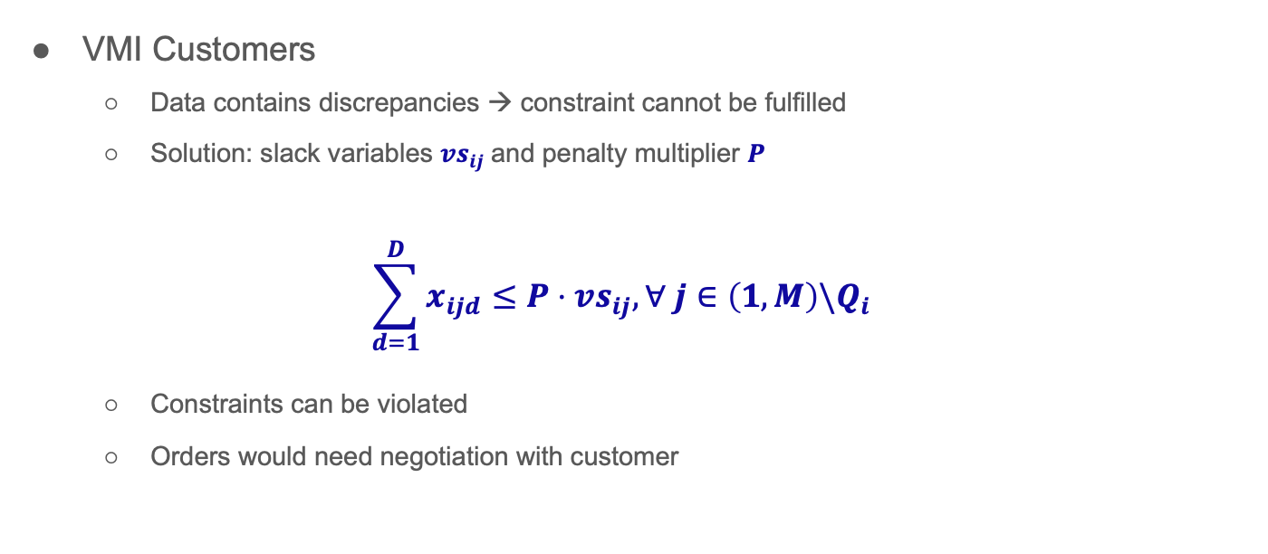
EQUALITY CONSTRAINTS (part.3b)
VMI Customers
Data contains discrepancies → constraint cannot be fulfilled
Solution: slack variables ${vs}_{ij}$and penalty multiplier $P$
$$\sum_{d=1}^{D}{x_{ijd}}≤P⋅{vs}_{ij}, ∀ j∈\left(1,M\right)\backslash Q_{i}$$
Constraints can be violated
Orders would need negotiation with customer

Slide 14
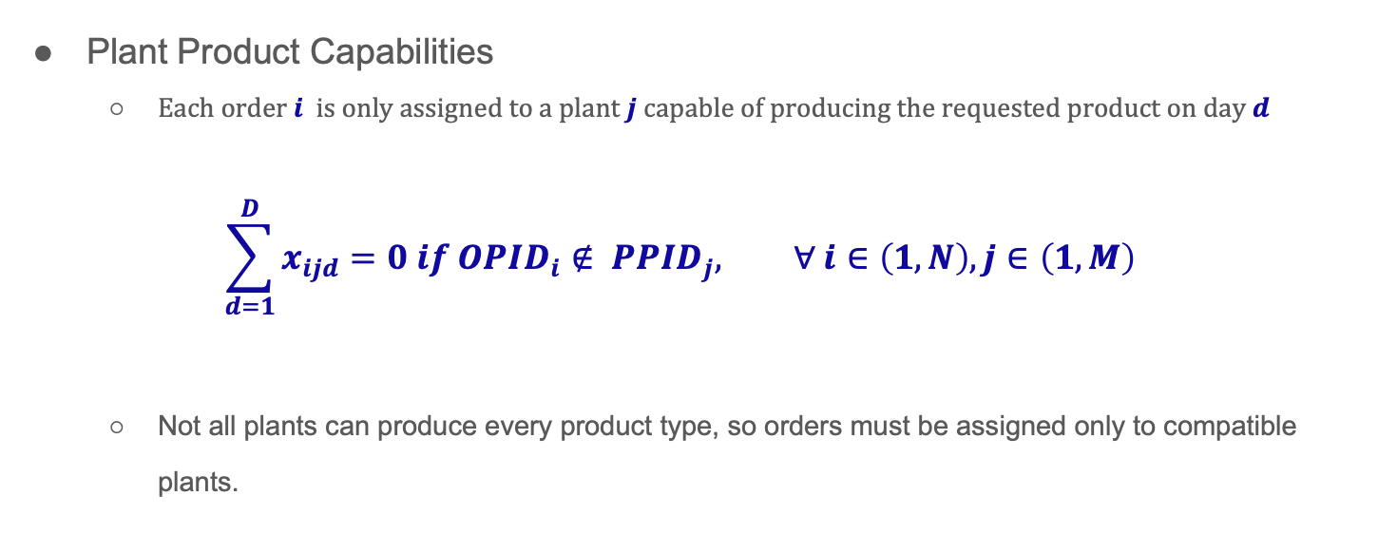
EQUALITY CONSTRAINTS (part.4)
Plant Product Capabilities
Each order $i$ is only assigned to a plant $j$ capable of producing the requested product on day $d$
$$\sum_{d=1}^{D}{x_{ijd}}=0 if {OPID}_{i}∉ {PPID}_{j}, ∀ i∈\left(1, N\right), j∈\left(1, M\right)$$
Not all plants can produce every product type, so orders must be assigned only to compatible plants.

Slide 15
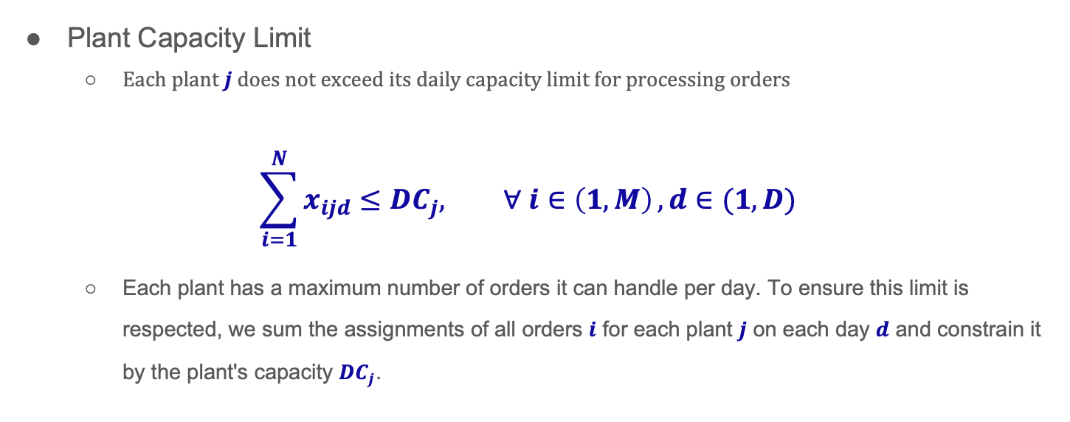
INEQUALITY CONSTRAINTS (part.1)
Plant Capacity Limit
Each plant $j$ does not exceed its daily capacity limit for processing orders
$$\sum_{i=1}^{N}{x_{ijd}≤{DC}_{j}, ∀ i∈\left(1, M\right)}, d∈(1,D)$$
Each plant has a maximum number of orders it can handle per day. To ensure this limit is respected, we sum the assignments of all orders $i$ for each plant $j$ on each day $d$ and constrain it by the plant's capacity ${DC}_{j}$.

Slide 16
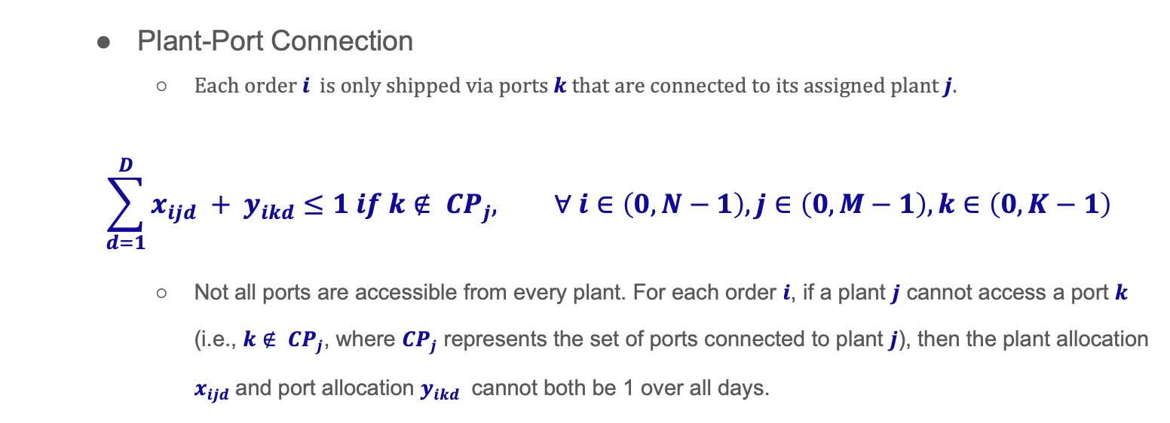
INEQUALITY CONSTRAINTS (part.2)
Plant-Port Connection
Each order $i$ is only shipped via ports $k$ that are connected to its assigned plant $j$.
$$\sum_{d=1}^{D}{x_{ijd} + y_{ikd}}≤1 if k∉ {CP}_{j}, ∀ i∈\left(0, N−1\right), j∈\left(0, M−1\right), k∈\left(0, K−1\right)$$
Not all ports are accessible from every plant. For each order $i$, if a plant $j$ cannot access a port $k$ (i.e., $k∉ {CP}_{j}$​, where ${CP}_{j}$ represents the set of ports connected to plant $j$), then the plant allocation $x_{ijd}$and port allocation $y_{ikd}$ cannot both be 1 over all days.

Slide 17
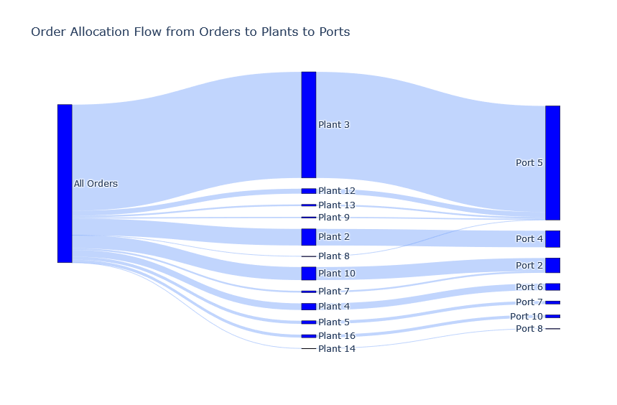
RESULTS
$$16.18 Mio. \$$$
Figure 1: Sankey diagram of order allocation

Slide 18
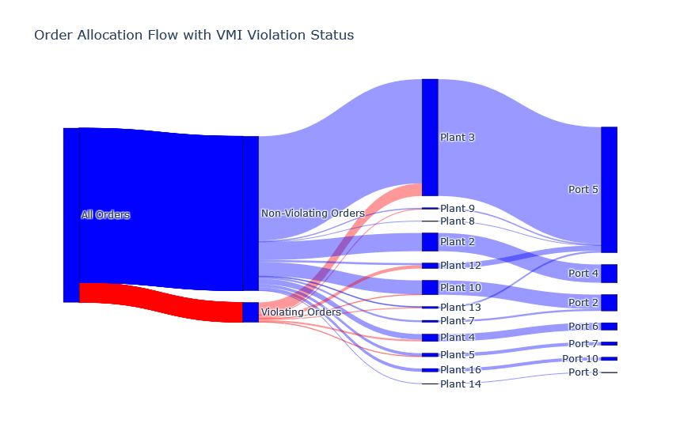
RESULTS
Figure 2: Sankey diagram of order allocation with VMI violations highlighted

Slide 19
REFERENCES
[1] Kalganova, Tatiana, & Dzalbs, Ilja. (2019). Supply Chain Logistics Problem Dataset. Brunel University London, 2019. Available: https://brunel.figshare.com/articles/dataset/Supply_Chain_Logistics_Problem_Dataset/7558679?file=20162015

